Slide 1
The Science of Climate Change
By
Leonard “Pete” Carter, PhD
Adjunct Prof. of physics, DSU
Presented:
Feb. 8, 2018 St. George Library
September 5, 2018 Washington City library

Slide 2
Presentation Outline
What this talk is about and what it’s not about, and a few ground rules
The basics of greenhouse gases (GHG) and climate change science
The only thing that counts is data – the complexities and potential problems of data acquisition, processing, calibration, and merging data sets
Climate (and related) data in its final form: A family of plots
Examples of misuse/misinterpretation of data
The ability (or not) of models to reflect data
Trends in fossil fuel usage and its finite supply
How some major corporations are addressing global warming
Possible unconventional solutions rather than “just burn less”
Questions and comments

Slide 3
Preamble
The topic of human-caused global warming, or Climate Change (CC), has become very politicized
This talk covers only the current state of scientific evidence and directly related topics
One exception: Brief discussion at the end on societal responses, present and future
Any “evidence” for or against CC must be critically and objectively evaluated: There are many bogus websites disseminating false or exaggerated information
Evidence presented here is either from government reports or professional journals
Primary sources are NASA, WTO (World Met Organization), NOAA (National Oceanic and Atmospheric Administration), and universities/institutes under contract, all non-political and pro-science
Questions or comments are welcome, but kindly refrain from anything of a political nature
This is strictly a presentation forum and NOT a debate forum

Slide 4
Why Climate is a Difficult Scientific Issue
It has a large number of interconnected interacting “moving parts”
Each part has it own “forcing function”, combining in ways that are not linear because they interact, thus making non-linear processes almost impossible to accurately model and predict, as in The Butterfly Effect
A significant component of climate is stochastic or non-deterministic (there is no possible way to predict an outcome)
Climate is probably influenced by variables we currently know nothing about, like seismic events, meteor flux, solar variability, subtle changes in the biosphere, etc.
Choosing which climate model is “best” depends on what characteristics are important and is an inherently subjective process

Slide 5
How Science is Done: the Positive Feedback Loop
Hypothesis and Theory
This feedback loop provides science with a built-in mechanism for self-correction. The box below is the judge which effectively decides on the correctness and validity of what comes from the box above. A crucial element of science is that every theory must be “falsifiable”.
Does the data agree with theory?
Does the theory agree with nature?
Experiment and Observation

Slide 6
The Feedback Loop as it Applies to Climate Change
Data relating to climate change is acquired, recorded and processed
Disparate data sets must be merged in building a long term plot
Possible explanations are developed and prioritized, including whether it’s “real” or a statistical fluke
Explanations form the basis for theories, which are further developed and updated for maximum agreement with existing data
Papers are published and gradually a consensus forms
As new data is made available, the consensus view is continually updated and modified and compared to competing theories
The process is NEVER complete: No theory is ever “set in stone”

Slide 7
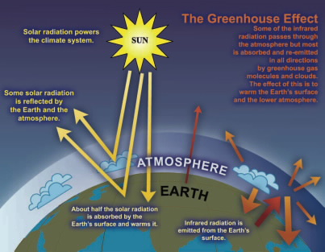

Slide 8
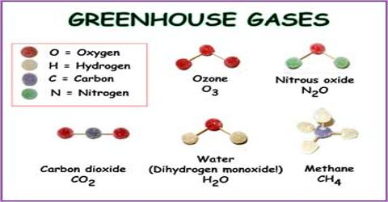

Slide 9
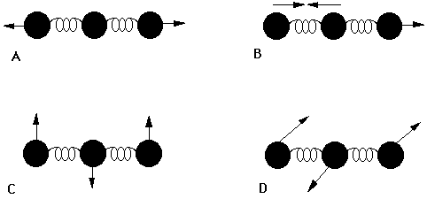
Greenhouse gas molecules, having at least three atoms, have many more ways in which they can de-excite after absorbing a solar radiation photon than can the atmosphere’s two-atom molecules N₂ and O₂. By getting rid of this absorbed energy, infra-red photons are emitted which end up as trapped thermal energy. Diagrams A, B, C, and D show various ways in which a three atom molecule can de-excite, in each case emitting an IR photon.

Slide 10
On the Physics of Radiation
The previous slide showed that infra-red (long wavelength) photons are more readily absorbed and re-emitted than visible light photons (short W.L.)
Only two things happen to photons in the atmosphere: Absorption or scattering (reflection is coherent scattering)
Both depend in part on the incident material, but there is one basic rule: Atmospheric scattering goes as the fourth power of frequency
In short: Scattering predominates at high frequencies, absorption at low freq.
The above explains why the sky is blue and sunsets/sunrises are red
Because absorption is greater at longer wavelength microwaves (125 mm W.L.) heat food but not light waves (0.0005 mm W.L.)

Slide 11
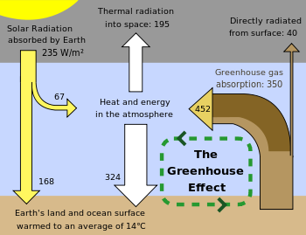
Total Solar Radiation: 1370 W/m²
Solar Radiation Scattered back into Space: 1135

Slide 12
Types of atmospheric feedback loops
Planetary response
Positive feedback - Venus
Runaway greenhouse effect
No feedback - Mercury
No atmosphere
Negative feedback - Earth
Cloud cover, vegetation uptake of CO2
Solar radiation intensity

Slide 13
The Complexities and Problems of Data Processing
What is acquired and recorded is raw data from sensors
Raw data must be (1) converted to physical units, (2) corrected and adjusted for instrument error and calibration settings, and (3) further adjusted to reflect standard operational conditions if needed
Any long term (decades) plots of processed data will be the result of the merging of several different data sets, each set potentially collected:
In different environments (rural becomes suburban becomes urban)
By different data collection teams using different protocols and procedures
By different instruments having different response functions to ambient variables
To be meaningful, each data set must be in a form that is totally compatible with the others to avoid an “apples-to-oranges” comparison
A data plot that shows discontinuities (jumps or dips) indicates that the merging process was not performed correctly
Because this requires adjusting temperatures, some have claimed that this is evidence of a deliberate hoax by climate scientists

Slide 14
Next Plot

Slide 15
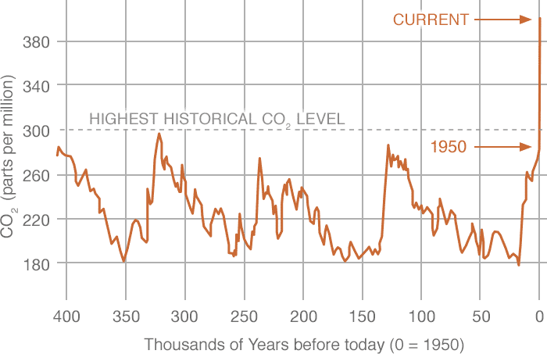
Historical Record of Atmospheric CO2 Levels
400 ppm
Rise of 2.0 ppm/yr
Next Plot
Rise of 0.015 ppm/yr

Slide 16
Acceleration in CO2 increase in recent era
0.015 ppm/yr

Slide 17
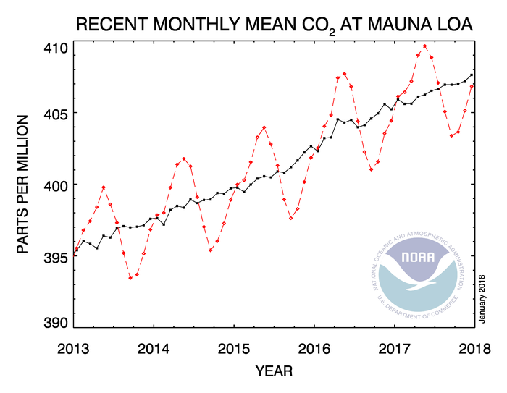
Atmospheric CO2 concentrations through 2017, from Mauna Loa Observatory, Hawaii
Average value for each month
Average value with seasonal variation subtracted out

Slide 18
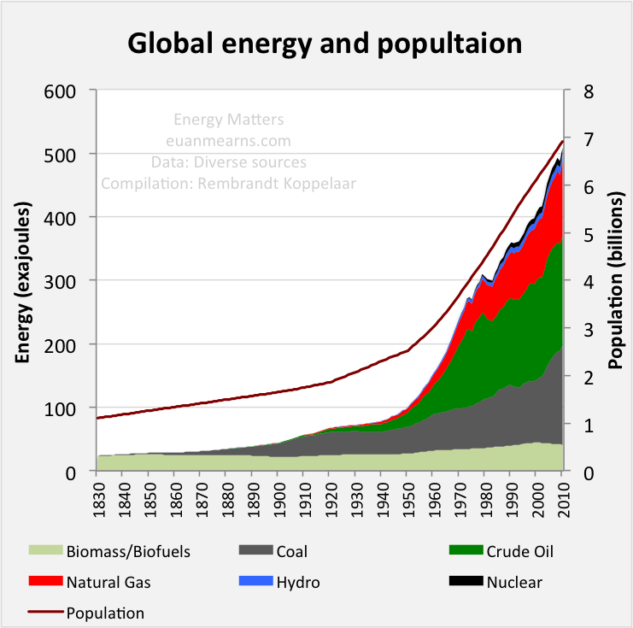
1 exajoule = 10¹⁸ joules
Approx. 30 Gw for 1 yr. (1 Gw = 1 billion watts)
Start of significant fossil fuel burning (1880)

Slide 19
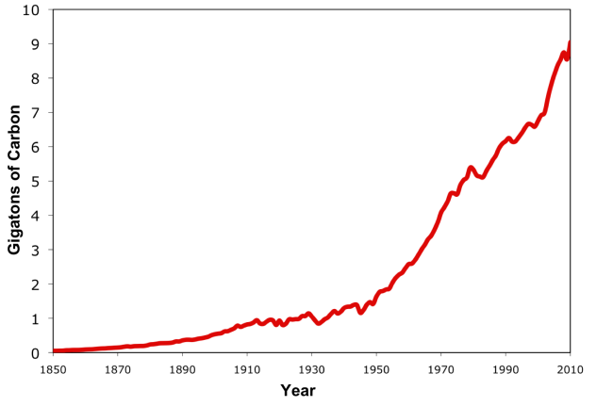
CO2 Added to the Atmosphere through Fossil Fuel Burning
(Billions of Metric Tons of Carbon, 1 Metric Ton = 1000 kgm/2200 lb)
Total emissions since 1880: 420 Gt C or 1540 Gt CO2.
Divided by total mass of atmosphere (5265000 Gt)
means addl. CO2 concentration of 290 ppm, but only
41% (120 ppm) retained in atmosphere, increasing
concentration from 280 ppm to 400 ppm.
1880

Slide 20
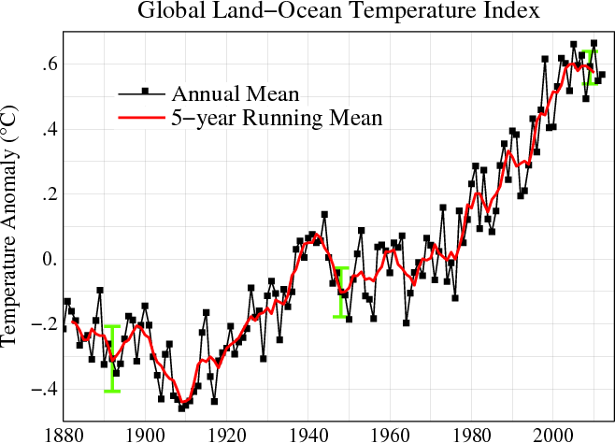
Global Mean Annual Temperature (Relative to 1945 as Reference year)

Slide 21
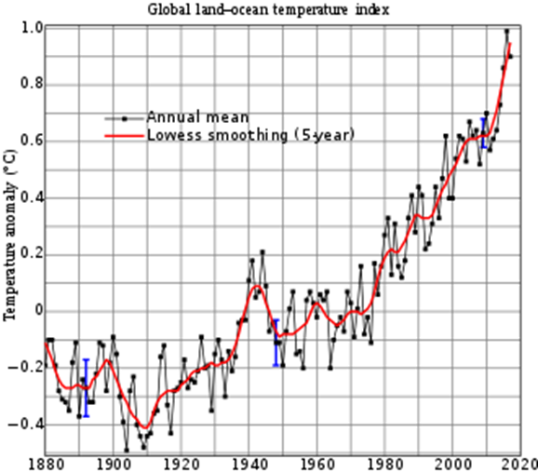
Global temperature increase – updated to 2016

Slide 22
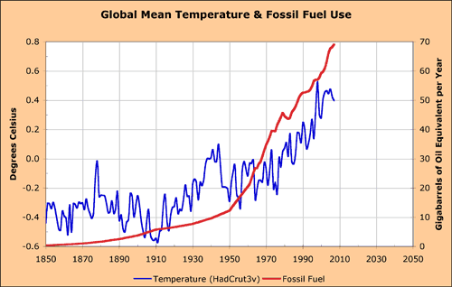
Fossil fuel use and Global Mean Temperature

Slide 23
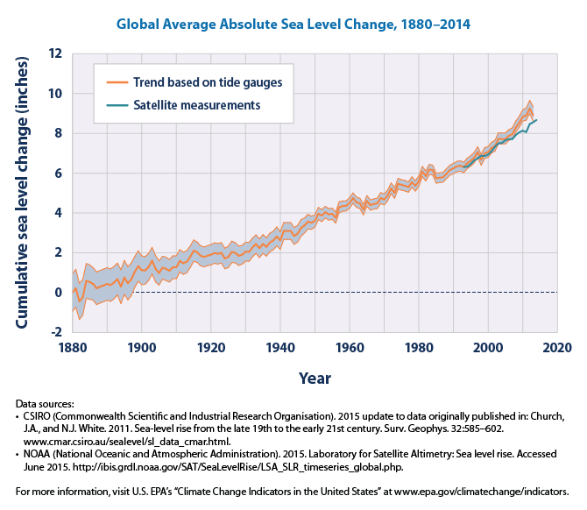

Slide 24
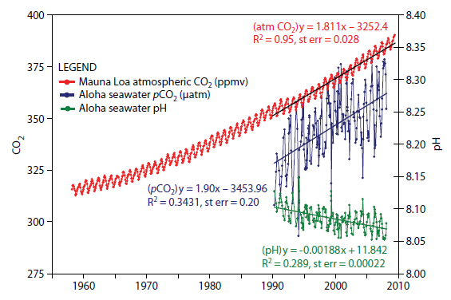
Oceans have become more acidic (lower pH) with increases in CO2 levels

Slide 25
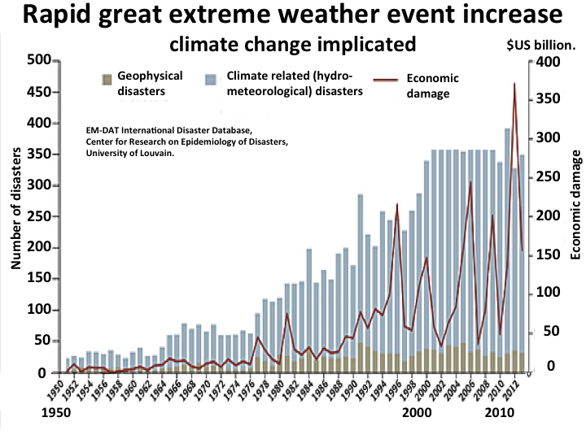
Rise in Extreme Weather Events

Slide 26
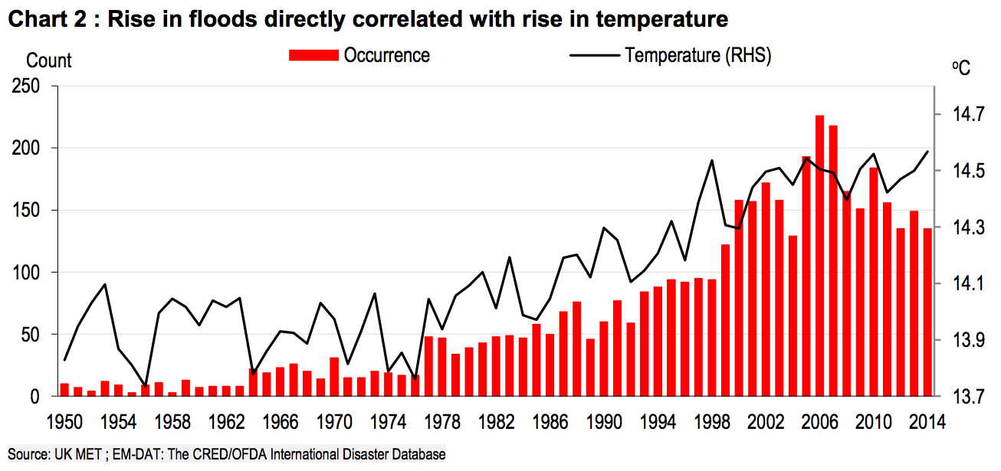

Slide 27
The one effect with the greatest societal impact: Sea level rise
Property values are already being affected:
A Harvard U. study of 100,000 Miami properties found that values for coastal homes are worth 10% less than if CC was absent
A joint U. of CO/U. of Penn study found that homes exposed to CC-caused flooding are worth 7% less than those not exposed
“Nuisance” flooding of some Miami homes at king tide are now common occurrences
The rate of rise has accelerated from 1.4 mm/yr during the 20th century to 3.4 mm/yr over the past five years
At this rate of acceleration, sea levels could be 2 to 4 ft higher by 2100
Every vertical 1 inch rise results in the ocean moving inland 4 to 8 ft, thus a 3 ft rise by 2100 means a coastal edge migration of 140-280 ft
The long-term worst case: If both the Greenland and Antarctic ice sheets melted the sea level would rise 220 ft, putting many coastal cities completely underwater

Slide 28
Ways in Which Data is Misused
Cherry-picking the available data – accepting only certain sets or subsets because they support a pre-drawn conclusion
Incorrectly perceiving data calibrations/adjustments in merging data sets as “massaging” or “fudging” the data to fit one’s theory
Insisting the data is invalid and has been fabricated or exaggerated to enhance and promote the researcher’s career and ensure future funding
Confusing a normal statistical fluctuation as a genuine trend reversal
Assuming that ALL climate variations must be natural simply because all past ones were (faulty inductive reasoning)
Accessing and examining communications (typ. Emails) of researchers engaged in data analysis, reaching a false conclusion as a result
Arriving at a conclusion of questionable validity due to a lack of complete understanding of what the data represents and the collection process
Putting model output “data” and real-world data on the same credibility level – concluding that, if one is bad, then the other is as well (invalid generalization)

Slide 29
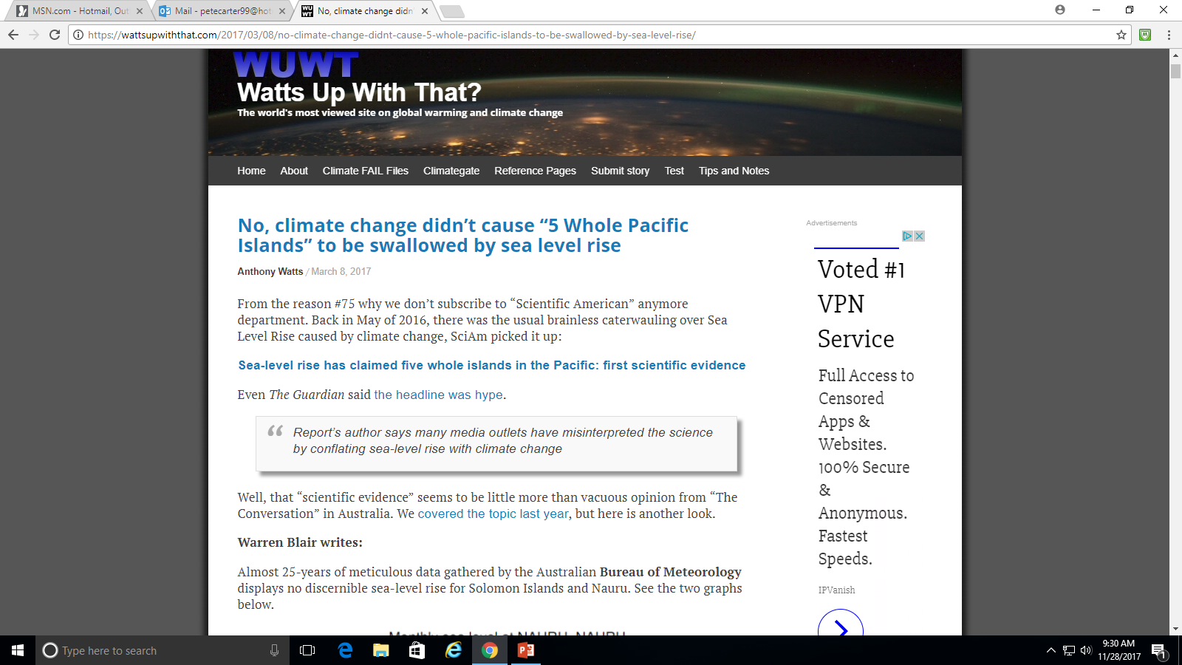
Notable Misuses/Misinterpretations of Data

Slide 30
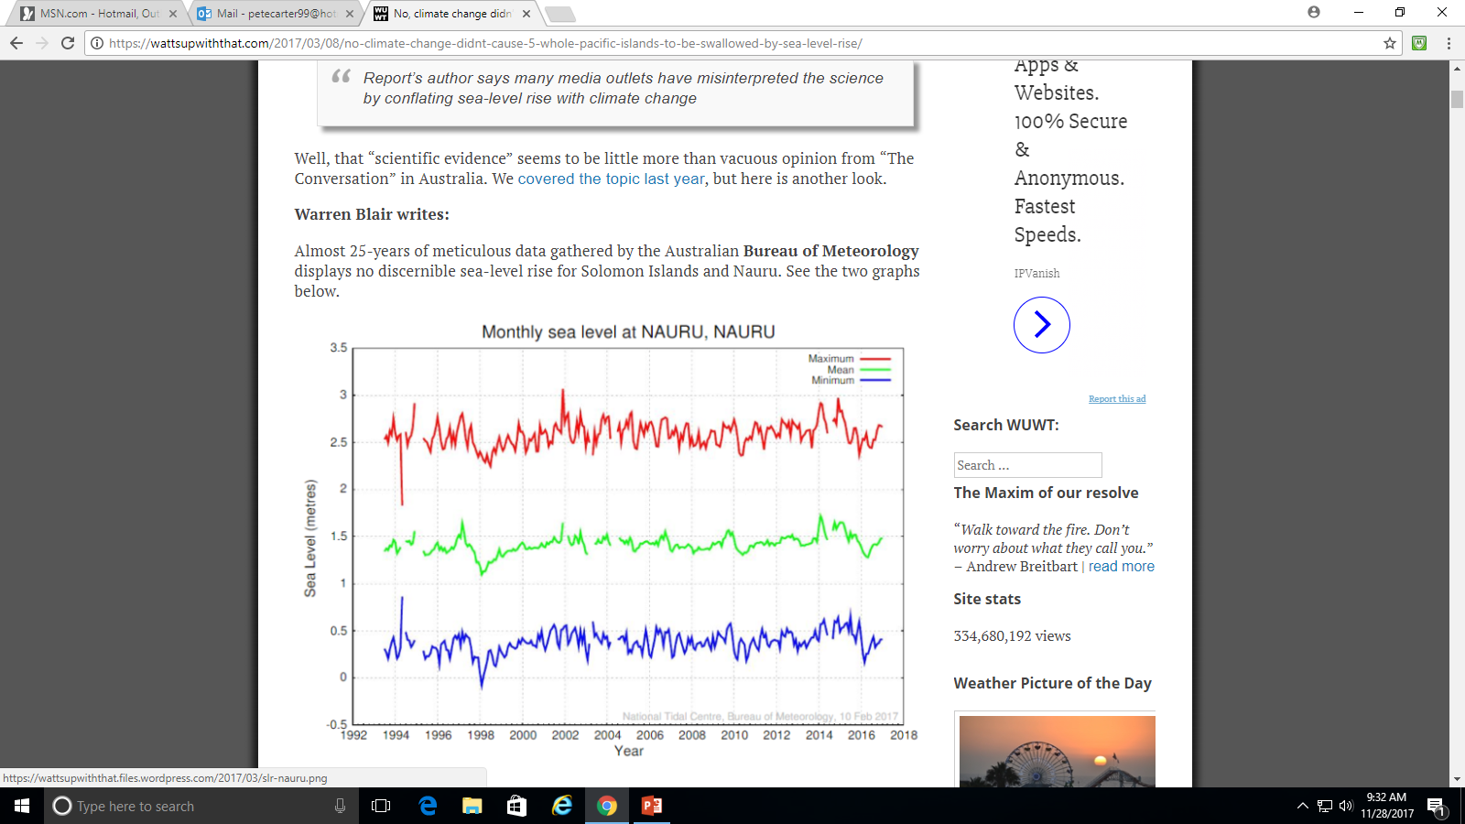
Sea level scaled in METERS!

Slide 31
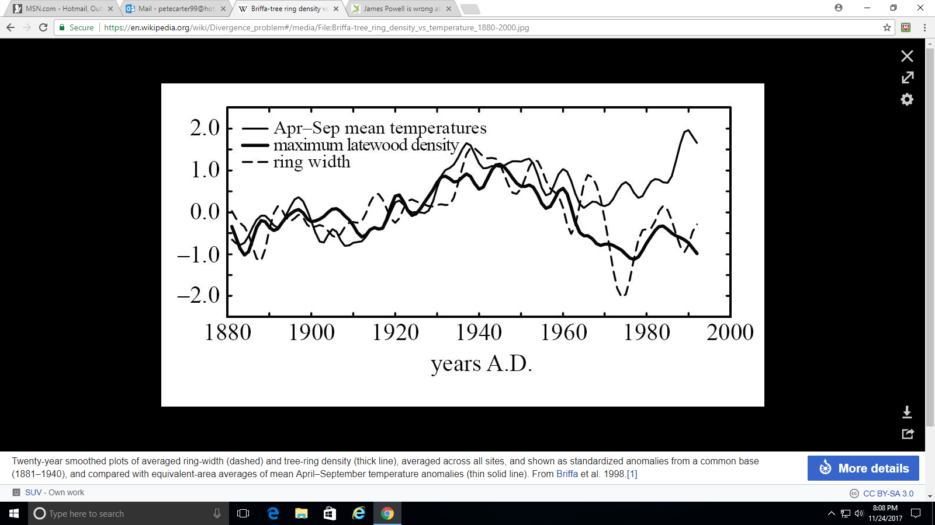
The University of East Anglia Climatic Research Unit Controversy

Slide 32
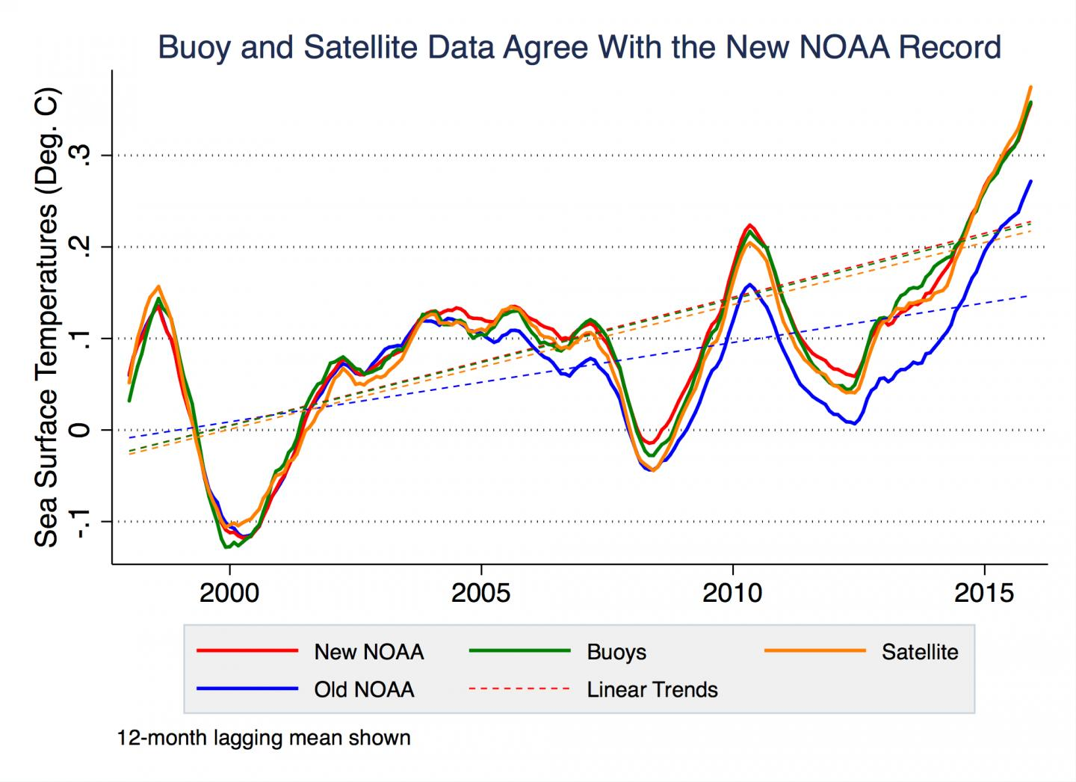
The Global Warming “Hiatus”
cooling
cooling
cooling

Slide 33
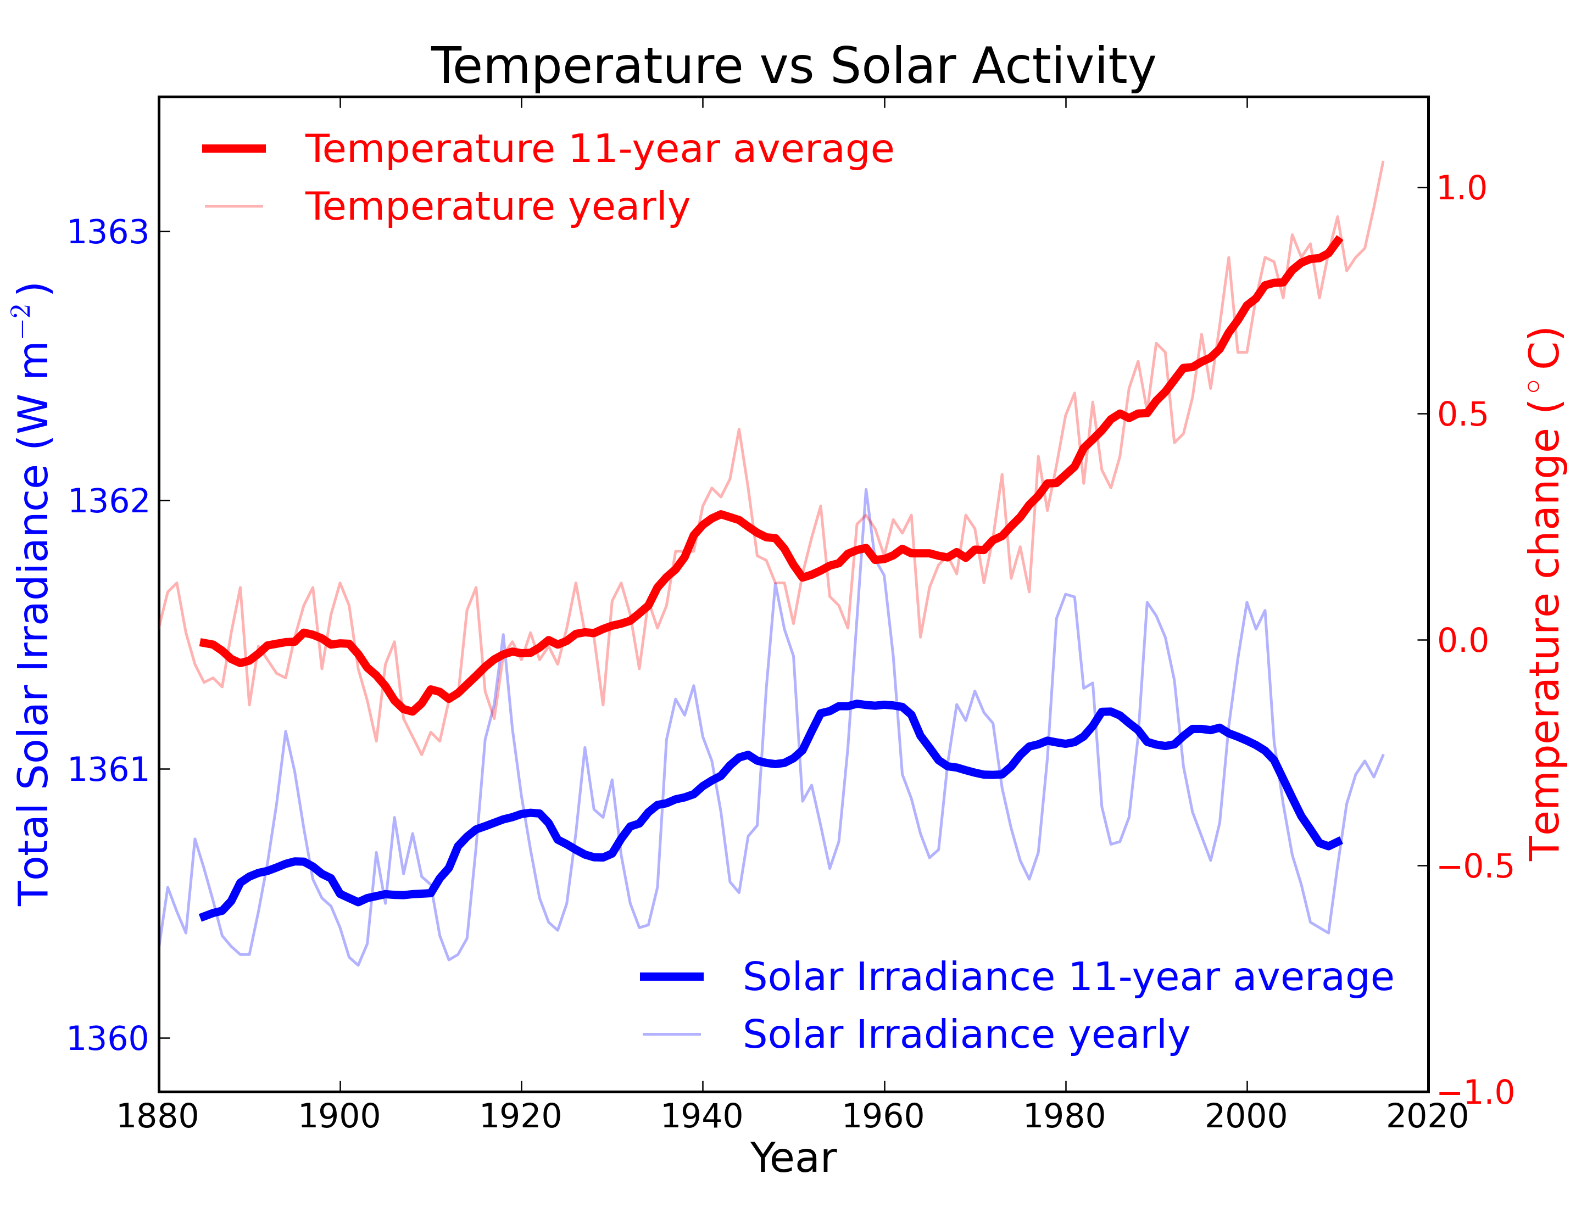
Decrease in Sunspot Activity and Solar Irradiance
Global temperature still rising as of 2015
70 yr minimum cited as evidence for “solar cooling””

Slide 34
There is no Incentive for Scientists to Falsify Data
There have been a few rare (and highly publicized) exceptions
Falsifying data eventually backfires – others will try to duplicate results
When exposed, deliberate falsification often leads to termination of career
If experimental effects are small, data might show false results that are later published – Ex: U of U researchers Pons and Fleischman claim of cold fusion in 1989
Scientists are like everyone else – they make mistakes, often work by trial and error
Oftentimes research is a gradual process that converges to the correct answer as a consensus builds
In ANY area of science there is ALWAYS a minority holding opposing views –
Ex 1: Flat-earthers claim their views are “science-based”
Ex 2: Creationism passed off as “science” to refute evolution
Ex 3: Anti-vaccine advocates use pseudo-science studies to support their views
Ex 4: Star Trekies insist there is “science” to support fantasies like FTL travel

Slide 35
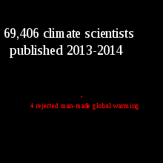
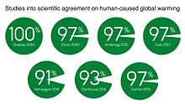
Agreement among climate scientists is almost unanimous

Slide 36
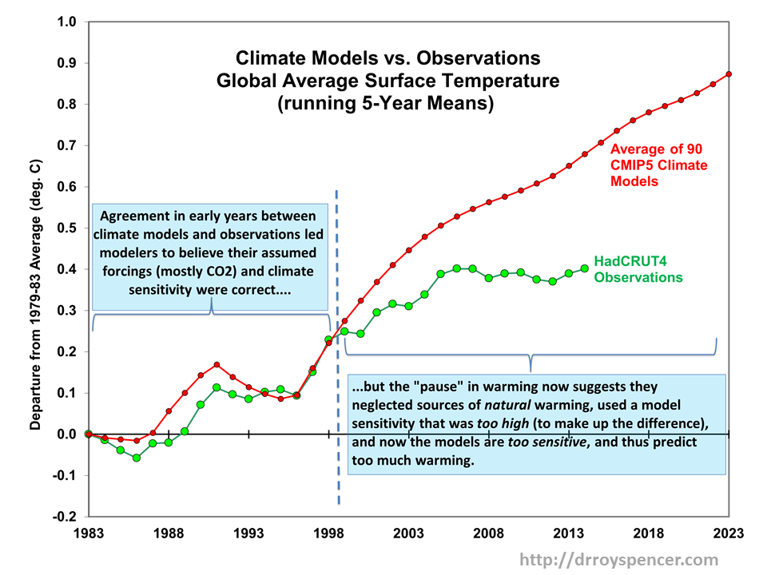
Most Climate Models are Poor Predictors

Slide 37
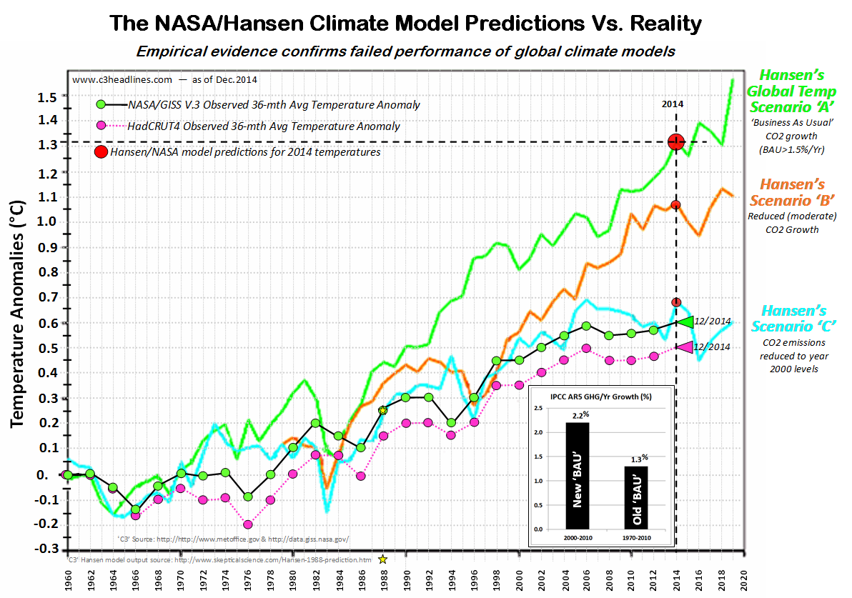
NASA Climate Models Show Excessive Warming

Slide 38
Most Models Overestimate Warming Effects

Slide 39
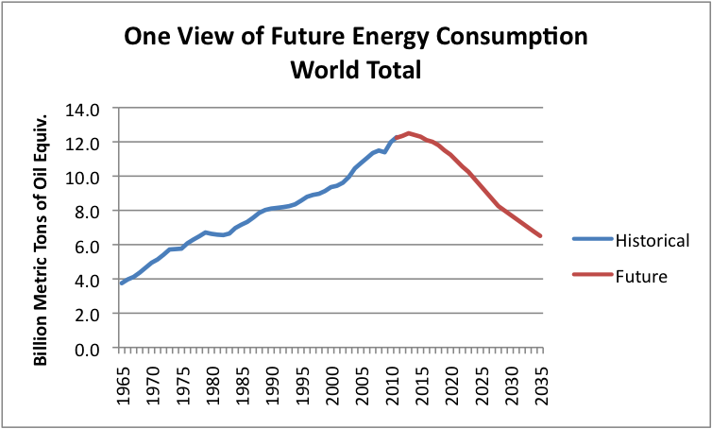
Consumption Trends – Exhausting the Supply
Current estimates for how long the global supply will last:
Crude oil – 70 years
Natural gas – 100 years
Coal – 500 years

Slide 40
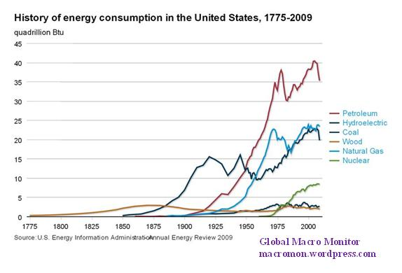
Domestic Fossil Fuel Mix

Slide 41
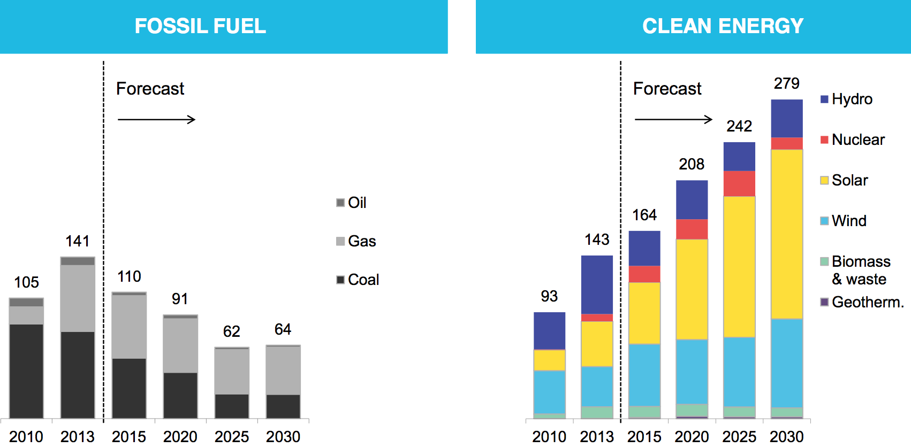
Fossil Fuel Use will be in Steady Decline
Power generation additions in Gw
Source: Bloomberg New Energy Finance

Slide 42
Many Major Corporations are Addressing Climate Change
Exxon Mobil – in partnership with Synthetic Genomics, developed genetically modified strain of algae that converts CO2 to oil
Google, Walmart, B of A, J&J – plans in place to eventually get 100% of needed energy from renewables, with varying deadlines
IBM – programs in place to minimize GHG emissions with yearly absolute emissions reduction targets
Electric Utilities (Duke Energy, Southern Co., AEP, Xcel Energy) – reduced CO2 emissions by 28-37% since 2005 through increased use of natural gas
Utah Intermountain Power Project – 1900 MW coal-fired plant near Delta, will convert to natural gas by 2025
Moody’s credit rating service – in November 2017, put a number of coastal communities on notice to either prepare for CC-caused extreme weather events or face credit downgrades

Slide 43
Summary Findings of the 4th National Climate Assessment
Released November 3, 2017 by the Trump Administration
Prepared by the U.S. Global Change Research Program, comprising 13 federal agencies within the Executive Branch
Concludes that it is extremely likely that human activities are the dominant cause of observed warming since the mid 20th century, and that:
There is no convincing alternative explanation supported by the observational evidence
Based on thousands of studies conducted around the world that have documented:
Changes in surface, atmospheric, and oceanic temperatures
Melting glaciers and diminishing snow cover
Shrinking sea ice and rising sea levels
Ocean acidification
Reference: https://science2017.globalchange.gov

Slide 44
Unconventional Methods to Alleviate Global Warming
Sequestering carbon –
Grow and then bury rapid-growth trees
Cultivate phytoplankton farms – most effective CO2 sink/O2 source
Build CO2 scavenging plants, supply to oil drillers for EOR or ground injection
Use of biofuels –
Develop GMO microbes that convert agricultural waste to natural gas
Convert vehicle engines from gas/diesel to cleaner CNG/LNG
Reducing solar insolation –
Put up large number of satellites that deploy “space umbrellas” – proven 50 year old technology from elint satellites that deploy huge antennas
More than one way of getting satellites in orbit: Space elevator, EM rail gun, trans-orbit two stage vehicle

Slide 45
Why drastic measures are not needed -- yet
Almost all models exaggerate the rate of warming
Current trends are already in the right direction for:
Powerplants (switch to renewables, cheaper cleaner gas replacing uneconomical coal)
Vehicles (electric and hybrids vs. gas/diesel, smaller leaner-burning engines)
Buildings (solar roof installations increasing at rapid rate)
As global fossil fuel supplies diminish, consumption will decrease at an accelerating rate; moreover, some govts./corporations plan on stopping IC engine or ICE-only vehicle production
There are other remedial measures available beside “just burn less”
Both the biosphere and humanity have shown amazing abilities to adapt in the past

Slide 46
In Summary:
Human-caused global warming is real
Global warming has been shown to have a multitude of environmental consequences
The above conclusions have been validated by thousands of studies spanning decades conducted by tens of thousands of researchers
The scientific community is not perpetrating a gigantic “hoax” – they have no motive
Climate models have been notoriously poor in reflecting trends
Warming will continue but there is a high likelihood that the rate will drop as society reduces fossil fuel use and corrective actions take effect
There are technologies available but unused that can mitigate warming
Continuing study is needed and some corrective measures are in place and growing, driven by free-market economics

